Slide 1
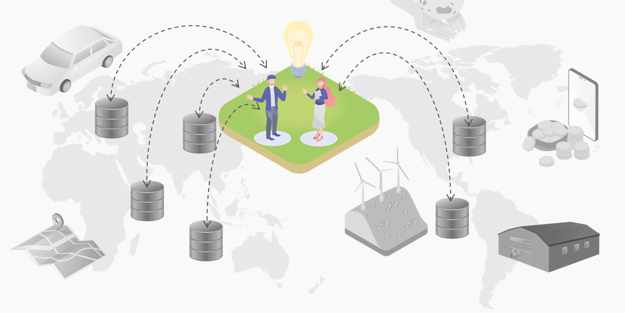
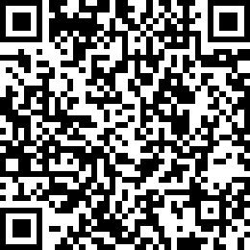

Digital Infrastructure Center
Digital Engineering Department
data space group
Download
Introduction
to data spaces
2023-Dec-19
Digital Infrastructure Center (DISC)
Digital Engineering Department
Data Space Group

Slide 2
About this document
This document is for beginners who want to learn about "Data Spaces”.
The Purpose is to understand,
What are data spaces
What is the organizational structure for data spaces promotion
What use cases are expected in Japan
Notes:
The intended target is those who want to learn about "data spaces" for the first time.
The purpose is to understand what are data spaces, the organizational structure for data spaces promotion, use case, etc.

Slide 3

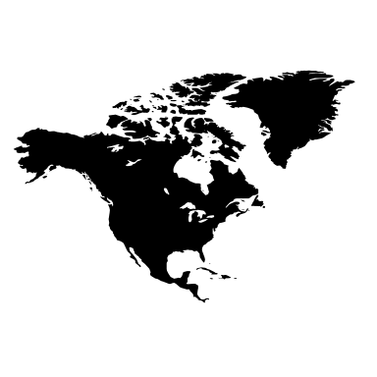

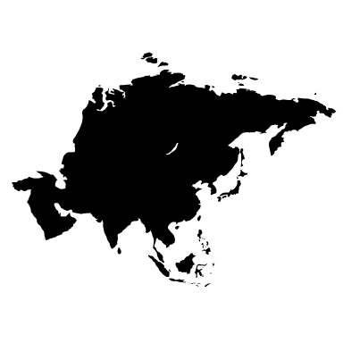
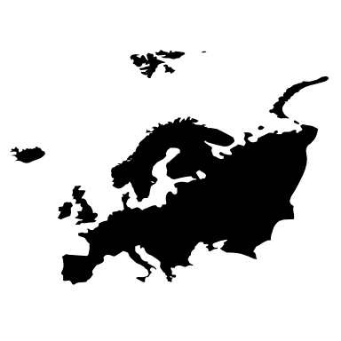





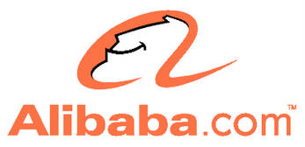
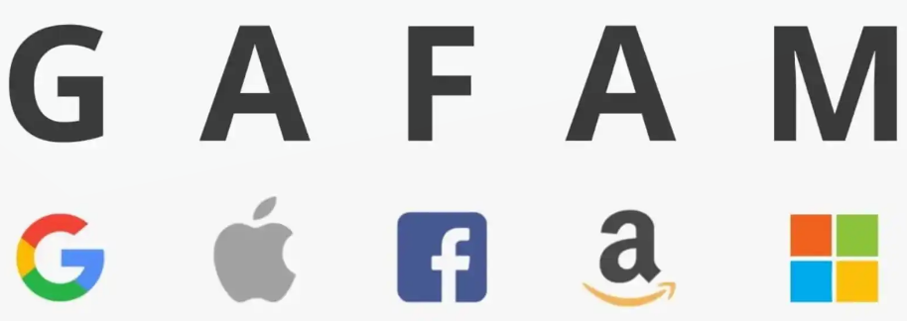
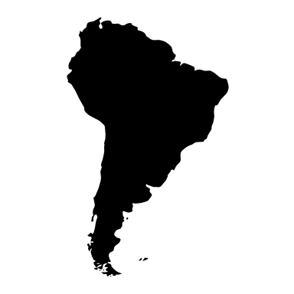

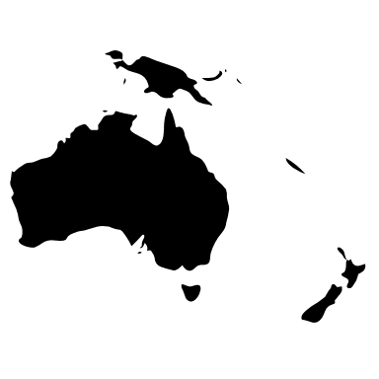
Background: global data spaces initiatives
EU, US, and China are increasing their competitiveness and influence by being ambitious over data linkage methods. It is imperative that measures be taken in Japan's domestic industry.
EU
USA/China
Data spaces from the
social economic activity data accumulation
Data spaces from the
personal economic activity data accumulation
Data collection
Develop data infrastructure and rules to collect large amounts of data from society.
Activities
Data collaboration across countries and organizations can now be done securely and quickly, and the use of data by companies will rapidly advance.
Data collection
Huge companies alone collect vast amounts of personal data.
Activities
Utilize big data collected by platformer to develop services.
International standardization led by the EU
De facto standardization led by stand-alone companies
Notes:
The EU, US, and China are increasing their competitiveness and influence by being ambitious over data linkage methods.
It is imperative that measures be taken in Japan's domestic industry.
In the U.S. and China, services are being developed by utilizing big data collected by stand-alone companies. As a result, services are becoming de facto standards.
On the other hand, in the EU, in order to realize data collaboration across countries and organizations, data infrastructure and rules are being developed, vast amounts of social data are being collected, and international standardization is progressing under the EU initiative.

Slide 4





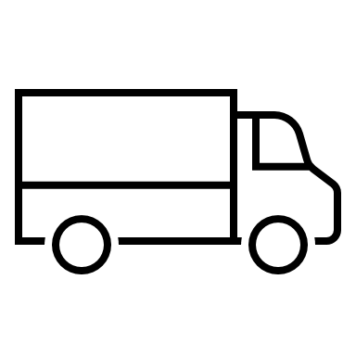





What are data spaces?
Concept that focuses on indispensable data in the digital society.
Standardized mechanism that ensures reliability and data sharing among different organizations, countries, and different industries ecosystems.
- Large amount of "diverse" and "reliable" data can be used with security.
International expansion/cooperation
Data providers
Data consumers
(Use cases)
Data spaces
* Data is retained by the provider, not centrally.
EU
data spaces
Cross-industry/cross-sectoral
(cross domain)
data spaces
Manufacturing industry
data spaces
Energy industry
data spaces
data
Use data
US
data spaces
IoT
data
data
Financial industry
data spaces
AI Utilization
Smart city
India
data spaces
Distribution industry
data spaces
Use data
Administrative field
data spaces
data
data
ASEAN
data spaces
data
Use
digital infrastructure
Common services Common functions
Digital infrastructure
Reference model
DFFT
(Data Free Flow With Trust)
Reliable and free data flow
Data analysis
Digital Transformation
Notes:
What are data spaces?
・Concept that focuses on data indispensable in the digital society.
・Standardized mechanism that ensures reliability and data sharing among different organizations, countries (ecosystems), and different industries.
・Large amount of "diverse" and "reliable" data can be used with confidence.

Slide 5

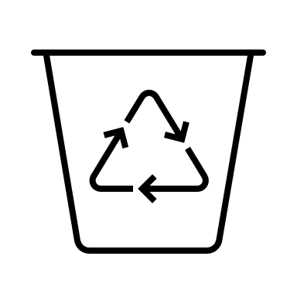







Advantages of data spaces
Widespread use of data spaces will contribute to the realization of "Society 5.0 *1,"
which combines economic development through data-driven management and solutions to social issues.
Business benefits
Social benefits
Realization of data-driven management
Privacy and a better life for everyone
1. Business speed improvement
Anyone can easily and quickly start a new business using data.
1. Sustainable
Enables the realization of a green society.
Analyze energy consumption data & use energy resources efficiently.
2. New business development
People with diverse expertise can work together for problems.
2. Knowledge/ convenient (by digital technology)
Optimize transportation systems using traffic data to ease
congestion and reduce travel time.
Provide more accurate weather forecasts by combining existing
weather data with IoT data, for example.
3. Better marketing strategy and early detection of problems
Advanced data analysis to discover new patterns and trends
and provide useful information.
3. Safe and secure
Forecasting: Predict future events (natural disasters, health crises,
etc.) and mitigate risks.
Disaster prevention: Ensure rapid evacuation guidance.
4. Adding value to data owned by the organization
Create value from data that has not previously been valued.
4. Equality and less disparity
Education (research data, education statistics, learning methods,
etc.), Business (businesses using data) will have equal opportunities.
5. Improved data security and cyber attack countermeasures
Confidentiality (can exchange data with trusted parties).
Integrity (can prevent data tampering) can be ensured.
*1 Society 5.0 is a data-driven society promoted by the government of Japan.
Notes:
Supplement
Describe each benefit with the reasons why they are brought about.
【Business benefits】
①Business speed improvement
Anyone can easily and quickly start a new business using data.
Reason: Availability of common tools, services, data, etc.
②New business development
People with diverse expertise can work together to solve problems.
Reason: Enables collaboration and information sharing between different researchers, organizations, and industry sectors.
③Improvement of marketing strategy, early detection of problems
Discover new patterns and trends with advanced data analysis to provide useful information.
Reason: Can use data that transcends fields such as consumer information and distribution information.
④ Own organization data has business value
Create business value even from data that has not been found to have value until now.
Reason: Easilly provide data to different organizations.
⑤Data security improvement and countermeasures against cyber attacks
・Confidentiality (can exchange data with trusted parties).
・Integrity (can prevent data tampering) can be ensured.
Reason: Has an organization, tools, and mechanisms in place to improve security.
【Social benefits】
① Sustainable society
It becomes possible to realize an environment-friendly society.
Analyze energy consumption data and use energy resources efficiently.
Reason: It is possible to collect data for each resource across the board, such as oil, gas, and wind power.
②Knowledge society / convenient society (utilization of digital technology)
Optimizing transportation systems using traffic data to reduce congestion and shorten travel times.
More accurate weather forecasts, for example by combining existing weather data with IoT data.
Reason: It makes it possible to use large amounts of a wide variety of data.
③Safe and secure society
・Prediction...to predict future events (natural disasters, health crises, etc.) and reduce risks.
Reason: can analyze and utilize information from IoT, such as sensors and cameras.
・Disaster prevention...Realize rapid evacuation guidance.
Reason: To enable coordination of transportation, electricity, gas, water, and communication infrastructure, and evacuation information from local governments
④A society with equality and less disparity
Education (research data, education statistics, learning methods, etc.), Business (businesses using data) will have equal opportunities.
Reason: The digital infrastructure makes it possible for anyone to utilize data.

Slide 6



Active and Inevitable aspects of data spaces
Sharing is inevitable and should be actively shared, by the concept of data sovereignty.
Active perspective
Data sovereignty
To enhance competitiveness, proactively utilize data linkage in business
“Data sovereignty" is a fundamental concept for trusting and sharing data in the data spaces.
Data providers can decide to whom and for how long data will be provided, etc.
New business development
Problem solving
1. Rights reserved by data provider
Utilize data from different industries
Analyze from a new perspective
Data spaces
Inevitable perspective
Data
Data
Data
Obligation and necessity, it is necessary to coordinate with regulations and international rules.
Data is managed by data owner
Data is not centrally managed
Regulatory compliance
2. Limited sharing to specific users
Prevention of isolation
Permission
Necessity to comply
with the rules
Other than Japan
Use data space
NG
Example: EU General Data Protection Regulation ( GDPR ) etc.
Notes:
There are reasons why data should be shared proactively in the data spaces (offensive perspective) and reasons why data must be shared (defensive perspective).
The offensive perspective is to proactively utilize data collaboration for business in order to enhance competitiveness.
This includes "developing new business" by utilizing data from different industries and "solving problems" by analyzing data from new perspectives.
The defensive perspective is the need to comply with regulations and international rules due to mandates and necessities.
In addition, in sharing data, "is it safe to share?". However, there is no need to worry because the data spaces are protected by data sovereignty.
Data sovereignty means that the data provider decides who to provide the data to and for how long.
①: Data is managed by the data provider, and data is not entrusted to some central location.
②: Data can only be released to specific users chosen by the data provider.

Slide 7


The image of data space characteristics and data exchange
“Interoperability” and “Data sovereignty” are particularly important characteristics of data spaces.
Three main steps for collaboration between data spaces
- first, data retrieval, second, authentication/authorization, and third, data transfer/access.
Data sovereignty
Data rights
Digital infrastructure
Commonly used
tools and services
Fairness
Available to anyone
Data catalog
cross search
Building Blocks
Common services/tools Common functions
Data provider
1. data retrival
1. search for data
Data user
Publication of
catalog site
Data catalog
Trust
Ensuring the reliability of the other party
Distributed service and data
The provider holds each data
Machine Usable
Available on computer
Contract
Contract
Connector
Connector
Data
Use in
application
Authentication/
Authorization
2. User authentication/authorization
Authentication/
Authorization
Data
Data
Data provided
3. Data transfer / access
Data acquisition
Use in
data analysis
A industry data spaces
Interoperability
Can exchange data with different parties
B industry data spaces
X industry
C industry data spaces
Notes:
The features of the data spaces are in red.
A particularly important feature is "interoperability," which allows data to be exchanged with different parties.
Another important feature is "data sovereignty," which protects the data rights of the data provider.
Data spaces collaboration mainly involves 3 steps.
① Search for data
② Authentication / Authorization
③ Data transfer / Aaccess

Slide 8




"Connector" that realizes data exchange
- By using connector, providers and users can connect each other and exchange the data.
- Connector is like “Outlet”.
"Appliances" can receive "electricity" by using the common “Outlet".
"Apps" can access "data" by using a common “Connector".
Outlet
Connector
Connector
Electricity
Data
App
N
Electricity
App
T
Data
Electricity
Data
App
S
8
Notes:
Under the digital infrastructure, the connector is the function of data exchange.
The connector connects providers and users and enables data exchange.
Connector is like a electrical outlet.
Since electrical outlet is commonly provided for home appliances, there is no need to consider and develop individual plans for accepting electricity.
In the same way, since connector is commonly provided for data integration, there is no need to consider and develop plans for accepting data for each individual application.

Slide 9

Benefits of using connector
When developing data exchange applications, the provided connector can be used to reduce the cost and time required for design and development.
Without connector
With connector
Design and development of data transfer with specific counterparties is necessary.
Reduce cost and time by using connectors
App
App
Preprocessing
Preprocessing
Design and development
Authentication/
Authorization
Use provided
connector
(provided)
connector
Burden the cost and time
Data exchange
function
Reduce the cost and time
Post-processing
Post-processing
Notes:
When developing data exchange applications, the provided connector can be used to reduce the cost and time required for individual design and development.

Slide 10
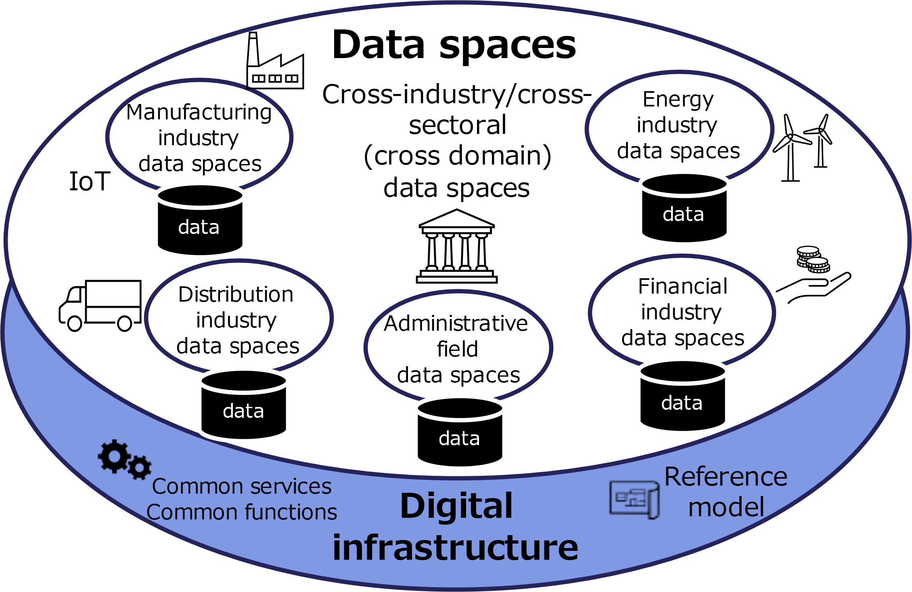


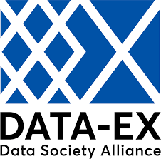

Digital infrastructure
Digital Infrastructure provides common services, tools, functions, and reference models underlying the data space in addition to connectors.
Common services and
tools
Need to accelerate maintenance
Common functions
GIF
data model
Guidebook
- Rule
- Standard
- Data model
Reference models
Example of common services, tools and “Building blocks (common function)”
1. Data search
2. Authentication/
Authorization
3. Data exchange
4. Data utilization
5. Development
environment
6. Guideline
Data catalog
ID service
Connector
AI/Analysis
OSS catalog
Knowledge
Data dictionary
Access control
Broker
Visualization
Test bed
Teaching materials
Base registry
Log management
Delivery
Knowledge Base
Test data
Market place
Billing management
Data management
Notes:
The digital infrastructure is the foundation of the data spaces.
Digital infrastructure includes common services, tools, common functions, and reference models.
It is provided by DATA-EX, the Digital Agency in Japan, and others, and is being developed in the future.

Slide 11

Differences from other data sharing structure
Comparing traditional data management and the structure of the data space is decentralized for reliability, interoperability, and data sovereignty *1.
Platformer type
EAI
(Enterprise Application Integration) *2
Data spaces
Structure type | Centralized
Characteristic | Platforms hold & handle data.
Sovereignty | N/A
Example | Google
Structure type | Distributed
Characteristic | Mechanism for exchange data between systems within a company.
Sovereignty | N/A
Example | Data Spider
Structure type | Federated
Characteristic | Can ensure reliability and share data between different organizations and countries
Sovereignty | Yes
Example | Catena-X
Company
User
Company
Cloud
Sales management
system
Company
User
Data
Data
Data
(centralized management)
Data
Data
Data exchange function
Connector
Connector
EAI
Data exchange function
EDI
Company
Company
Accounting management
system
Company
Company
User
Data
Data
Data
Data
Connector
Connector
Data exchange function
Data exchange function
*1: Whether or not the data provider can be involved in the handling of its own data.
*2: System that links multiple systems used for business within a company to efficiently integrate data and processes.
Notes:
The difference between traditional data management and data spaces.
In a traditional platform-based data management system, such as Google, the data is managed centrally by the platform.
The data provider, a company or individual, has no control over how their data is used.
In other words, the data provider has no data sovereignty.
In addition, in traditional EAI, the data is distributed, but the data provider does not have data sovereignty, just as in a platformer.
Data spaces are distributed and the data providers has data sovereignty.

Slide 12
Role in acceralating data spaces in Japan
Government of Japan, DSA, and IPA plan to work together to promote data spaces.
Policy/Strategy
Vision, Scope
Laws, Regulations, Implementing agencies, Management organization
Legal rules, Organization
Japan
Business, Function
Using data spaces for services, solutions
One Team
・Digital Agency
・Ministry of Economy, Trade and Industry
・Related ministries
・Information-technology Promotion Agency (IPA) *
・National Printing Bureau *
・Japan Institute for Local Government Information
Systems (J-LIS) *
・National Institute of Information and Communications
Technology (NICT) *
・Data Society Promotion Council (DSA)
...
Data space across industries and sectors
Data space by industry and sector
Data spaces
Digital infrastructure ( framework, platform )
Data catalog
Dictionary, ID
Development environment
Common service tools
Connector
access control
Common functions
Data utilization
Technical rules
data model,
vocabulary
Reference model
Guideline
* Strengthening cooperation is stated in the priority
policy program for realizing a digital society.
Base registry
Open data
Data
IoT/Sensor,
Hardware, Network
Assets
(Equipment/System)
Notes:
Domestically in Japan, related ministries, DSA , and IPA will work as "One Team" to promote data spaces.

Slide 13
Area of the data space
Data spaces are used in a wide range of fields in society.
Japan Standard Industrial Classification : Major Classification | EU | Japan
A. Agriculture, forestry | EDS agriculture | Semi-public (agriculture)
B. Fishery | Fishing | -
C. Mining, Quarrying, Gravel extraction | - | -
D. Construction | EDS construction | Smart buildings, Underground objects Land Transport PF
E. Manufacturing | EDS Industry / Industrial, Mobility | Intercompany transactions, Batteries
F. Electricity, Gas, Heat supply, Water industry | EDS energy | Water supply
G. Information and communication | EDS media | -
H. Transportation industry, Postal industry | EDS railway, mobility, aviation, shipping | Autonomous mobile robot Mobility (service)
I. Wholesale trade, Retail trade | - | -
J. Financial industry, Insurance industry | EDS Finance | Finance
K. Real estate business, Goods rental business | - | Land Transport PF
L. Academic research, Professional / Technical services industry | EDS cultural heritage | -
M. Accommodation industry, food service industry | EDS tourism | -
N. Life -related service industry, Entertainment industry | EDS tourism | -
O. Education , Learning support industry | EDS skills | Public Service
P. Medical care, Welfare | EDS health | Public Service
Q. Complex service business | EDS smart community | Public Service
R. Service industry (n.e.c.) | - | -
S. Public service (excluding those classified elsewhere) | EDS administration, Administration (law, procurement, safety) | Public personal authentication Public service
T. Unclassifiable industries | EDS green deal | CFP carbon footprint
In each field, one or more projects are underway, and there are many data spaces with limited functions or regions.
In Japan, there are many initiatives similar to data spaces.
* EDS: European Data Spaces
Notes:
Data spaces are used in a wide range of fields in society.
In each field, one or more projects are underway, and there are many data spaces with limited functions or regions.
In Japan, there are many initiatives similar to data spaces, such as quasi-public projects, although they are not called data spaces.

Slide 14

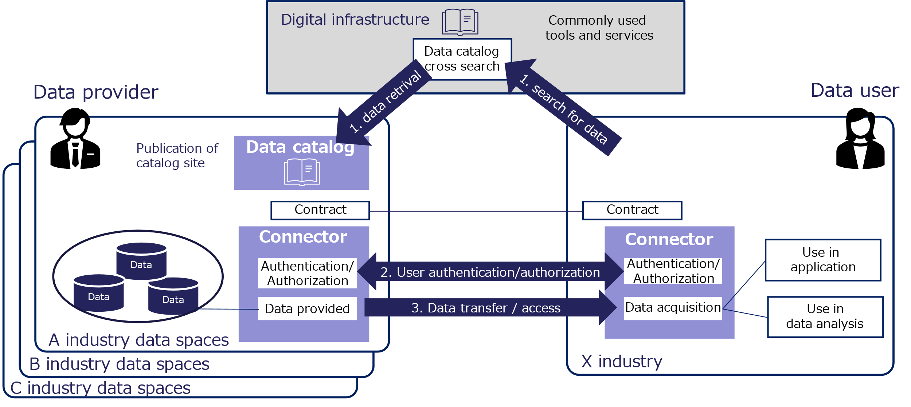
Case study (1) - Osaka City
“Super city concept”
Data spaces focus point
・Establishment of a digital infrastructure for industry-academia-government collaboration to eliminate the administrative
digital divide within Osaka.
・The usage of the catalog enables the provision of services utilizing Osaka open data.
Background
There was a disparity in efforts to utilize data among municipalities in Osaka Prefecture due to financial, human resources, know-how, and other limitations.
Aim for a society where all residents can access advanced digital services.
Effort
Osaka Prefectural Government will take the lead in making ID sharing possible starting in FY2022.
Establish a digital infrastructure and start providing services.
Establish an environment to provide a variety of digital services to those who need them, when they need them.
Effect
Development of Osaka digital infrastructure
-> 43 municipalities in Osaka can share the usage of data and services that
were previously disparate or fragmented.
ID sharing
-> Enables services to be linked and can provide personalized services.
Increased digitization of business operations improves operational efficiency.
Expected benefits
Business
1. Business speed improvement
2. New business development
3. Better marketing strategy,
catch the detection earlier
4. Adding value to data owned
by the organization
5. Improved data security and
cyber attack countermeasures
Social
1. Sustainable society
2. Knowledge society / convenient
society (utilization of digital
technology)
3. Safe and secure society
4. A society with equality and less
disparity
Focus points of this case
Notes:
Japanese domestic use case is a super city configuration in Osaka City.
The focus point of this case as a data spaces are as follows.
・The creation of a digital infrastructure for industry-academia-government collaboration that eliminates the administrative digital divide within Osaka City.
・The fact that the use of the catalog has made it possible to provide services utilizing Osaka City's open data.

Slide 15
Case study (2) - Sapporo City
“Marketing optimization”
Data spaces focus point
- Establish of a digital infrastructure for public-private partnership.
- Possibility of creating new business by combining open data provided by private sectors with open data and provided by the
Sapporo City.
Background
The public-private partnership digital infrastructure for coordinated use of public and private sectors data in the Sapporo area is being built and consider full-scale promotion of data utilization.
Effort
Estate developers and restaurants combine external data such as "weather data" and "event data" from outside the Sapporo City to confirm the optimization of marketing and business operations.
Conduct a demonstration experiment connecting CADDE connector to the Sapporo City's digital infrastructure.
Effect
Realize the optimization of marketing and business operations.
By using the connector when using external data, there is no need to develop separate interface functions for data exchange.
Expected benefits
Business
1. Business speed improvement
2. New business development
3. Better marketing strategy,
catch the detection earlier
4. Adding value to data owned
by the organization
5. Improved data security and
cyber attack countermeasures
Social
1. Sustainable
2. Knowledge/ convenient
(utilization of digital
technology)
3. Safe and secure
4. Equality and less disparity
Focus points of this case
Notes:
This is the Sapporo City Marketing Optimization of a Japanese domestic case.
The focus point of this case as a data spaces are as follows.
・The city has established a digital infrastructure similar to that of Osaka City.
・The potential to create new business by combining open data provided by other companies with Sapporo's open data.

Slide 16

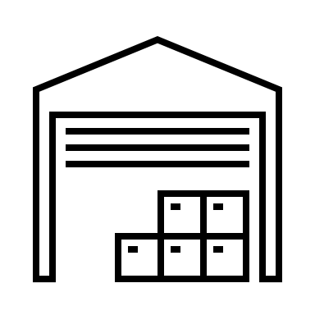





Idea of business Case
“Enhanced Marketing”
Understand consumer needs and improve marketing strategies.
Ensure credibility and the ability to provide and obtain data.
Effort
improvement marketing strategy based on consumption information data that the manufacturer has not been able to catch before.
Stores that previously refused to provide data on the grounds that the source of supply was unknown can now provide data because the reliability of the data is assured.
Effect
Manufacturer: Can catch up with consumer needs.
-> Leads to improve marketing strategy.
Sales store: Data that had no value create business value.
【Conventional】
Manufacturer
Company
Many sales stores
unclear consumer needs
Not directly connected
-> Low reliability
They doesn't want to provide data to unknowns
【Data spaces】
Expected benefits
Business benefits
1. Business speed improvement
2. New business development
3. Better marketing strategy,
catch the detection earlier
4. Adding value to data owned
by the organization
5. Improved data security and
cyber attack countermeasures
【Social benefits】
1. Sustainable
2. Knowledge / convenient
(by digital technology)
3. Safe and secure
4. Equality and less disparity
Company
Many sales stores
Manufacturer
Highly reliable
-> Consumer needs
catch up
Sell and provide data to trusted parties.
Visualization of consumer needs
Notes:
This is not an actual case, but a expected case for the future use of the data spaces.
The first expected case is the enhancement of marketing.
Data from manufacturers and retailers will be linked to understand consumer needs and improve marketing strategy.
The data will be reliable, so that retailers will be able to provide the data and manufacturers will be able to obtain it.

Slide 17
Inquiries
To promote data spaces, please contact us.
Contact
Digital Infrastructure Center
Digital Engineering Department
Data Space Group
E-mail disc-info@ipa.go.jp
Notes:
If you have any inquiries related to data spaces, please contact
the IPA contact page.

